Slide 1
Joins in SQL
SQL Day 6 class

Slide 2
Learning Objectives
By the end of this lesson, you will be able to:
Distinguish between INNER and OUTER joins.
Identify the types of outer joins

Slide 3
JOINs Combine Related Data
JOINs allow you to combine data from multiple related tables into a single result set.
JOINs Allow Powerful Data Integration
JOINs enable combining data from multiple tables into a single result
Match rows between tables based on relate columns like IDs
Fundamental SQL concept for working with multiple tables
Basis for many complex queries, reports, and analyses
Key Points:
JOINs integrate and connect data across tables
Match rows between tables based on related columns
Various types for including all or only matched rows
Essential for working with complex multi-table databases

Slide 4
JOINs Combine Related Data
Understanding JOIN Statement Components
SELECT columns - Fields to include in output
FROM Table1 - First table referenced in join
JOIN Table2 - Second table referenced
ON condition - Column logic that matches rows
Additional JOINs - More tables can be joined
Example:
SELECT *
FROM Table1
INNER JOIN Table2
ON Table1.id = Table2.table1_id;

Slide 5
JOINs Combine Related Data
Main types of SQL JOINS:
INNER JOIN:
Returns only matching rows from both tables based on the join condition.
Common join type used to combine rows with relationships.
Excludes rows from either table that don't satisfy the ON clause.
LEFT OUTER JOIN:
Returns all rows from the left table even if no matching rows in right table.
Right table columns are NULL if no match found.
Used to keep all rows from main table while adding data from secondary table.

Slide 6
JOINs Combine Related Data
Main types of SQL JOINS:
RIGHT OUTER JOIN:
Returns all rows from the right table even if no matching rows in left table.
Left table columns are NULL if no match found.
Reverse of left join, keeping all rows from "right" table.
FULL OUTER JOIN:
Returns rows from both tables, left and right sides.
Has result rows for every row in left OR right table.
Good for combining tables and seeing all data including non-matches.
Unmatched rows will have NULL values for the other table's columns.

Slide 7
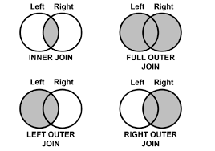
JOINs Combine Related Data

Slide 8
Importance of Relationships
Join Conditions - Critical Role
Relate tables for unified analysis
Filter and connect meaningful data
Foundation for SQL analytics
Leverage keys, data patterns
Balance precision and performance
Impacts:
Query and reporting capabilities
Depth of business insights
Understanding data interconnectivity
Making informed decisions

Slide 9
Join Conditions Related to Table Data
Defining Table Relationships
The ON clause specifies how two tables are related
It matches rows between tables based on column values
This connects related data across tables
Key Things to Know:
Essential component of table joining
Basis for linking and analyzing related table data
Filters query results based on defined relationships
Typically compare key columns like ID fields

Slide 10
Power of Defined Relationships
Why Define Table Relations in ON?
Join condition filters and maps related data
Enables viewing connected data in one result
Analysis can span multiple tables
Extends insights beyond individual tables
Entity relations become queryable like customers to orders
Unlocking Deeper Analytics:
Defining table relationships via join conditions enables deeper multi-faceted analysis not possible within individual tables.
Connecting entities creates opportunities for more impactful insights.
.

Slide 11
Matching Based on Key Columns
Typical Join Condition:
ON Customers.CustomerID = Orders.CustomerID
Relating Table Data via Keys:
Common for standardized relationships
Links core table entities like customers to transactions
Why Match on Keys?
Each customer has an ID in the Customers table
Orders link to a customer by storing their ID
Comparing IDs relates orders to the customer who placed it
.

Slide 12
Crafting Join Conditions
Flexible Join Logic:
Simple column equality
Equivalent more complex expressions
Multiple AND/OR conditional logic
Examples:
ON Customers.State = Orders.State
ON YEAR(Orders.Date) = Customers.StartYear
ON Customers.Points > 10000 AND Orders.Amount > 200

Slide 13
Crafting Join Conditions
Summary:
While join conditions can leverage complex expressions, the focus should be relating rows with meaningful connections between tables. Balance simplicity and specificity based on data analysis..

Slide 14
Why Use Join Alias
Join aliases are useful for assigning table aliases in JOIN statements to make queries easier to write and read:
Improves readability
Simplifies coding - You only need to type short aliases
Avoids ambiguity - Column name can be the same across tables
The syntax for a SQL JOIN with aliases is:
SELECT column_list
FROM table1 alias1
JOIN table2 alias2
ON alias1.join_column = alias2.join_column

Slide 15
Why Use Join Alias
Example with and without aliases:
Without aliases:
SELECT customers.name, orders.amount
FROM customers
JOIN orders
ON customers.id = orders.customer_id;
With aliases:
SELECT cust.name, ord.amount
FROM customers cust
JOIN orders ord
ON cust.id = ord.customer_id;

Slide 16
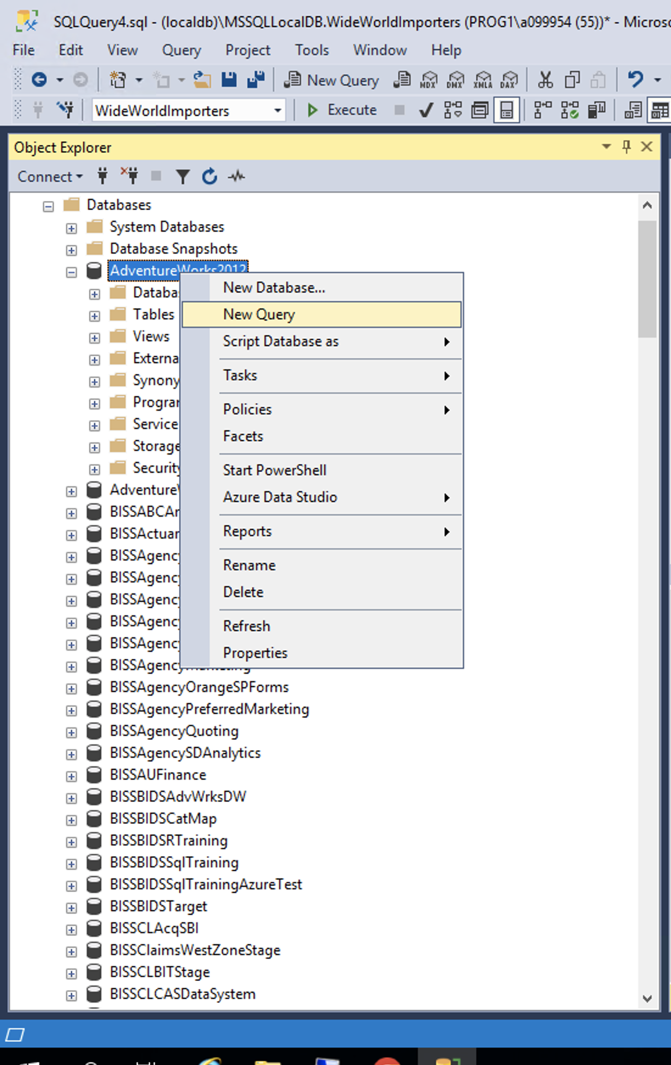
Prep
Using the AdventureWorks Database
Please open up SSMS
Connect to BISS
mss-p1-biss-01
Right click on AdventureWorks2012
Select new query

Slide 17
Inner Join Fundamentals
Inner Join Concepts
Ideal for assembling connected data
Result only includes related data
No duplication or missing values
Great for combining data about the same entities
INNER JOIN Example:
SELECT *
FROM TableA
JOIN TableB
ON TableA.id = TableB.tablea_id;

Slide 18
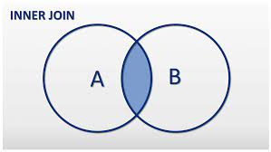
Inner Join Fundamentals
Key Points:
Foundation join to combine matched rows
Omits rows that fail the ON comparison
Output has columns from both tables
Links tables based on defined relationships
Other joins built on inner join foundation

Slide 19
Inner Join Fundamentals
The key differences between JOIN and INNER JOIN:
JOIN by itself implicitly means INNER JOIN
Using INNER JOIN explicitly adds the INNER keyword
They function the same way - matching rows where the ON condition is true
JOIN and INNER JOIN produce the same result set joining on a condition.
The INNER JOIN syntax just makes it more clear you are intending an inner join rather than a different join type.
For readability and self-documenting code, it is considered a best practice to use the explicit INNER JOIN syntax instead of just JOIN. But both terms refer to the same type of joining rows between tables.

Slide 20
Inner Join Fundamentals
Examples Using AdventerWorks2012:
Get product name and subcategory name:
SELECT p.Name, ps.Name AS Subcategory
FROM Production.Product p
INNER JOIN Production.ProductSubcategory ps
ON p.ProductSubcategoryID = ps.ProductSubcategoryID;
Get product model name and instructions:
SELECT pm.Name, pm.Instructions
FROM Production.ProductModel pm
INNER JOIN Production.Product p
ON p.ProductModelID = pm.ProductModelID;

Slide 21
Left Join Fundamentals
LEFT OUTER JOIN Fundamentals
Preserving Data from Left Table
Returns all rows from left table
Matches right side rows if join condition met
Right columns are NULL if no match
Keeps all left table data intact
LEFT JOIN Example:
SELECT *
FROM Customers c
LEFT JOIN Orders o
ON c.id = o.cust_id

Slide 22
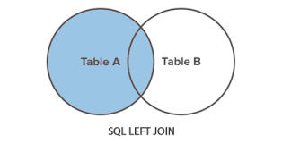
Left Join Fundamentals
Key Points:
Includes all left table rows
Joins right table matching rows
Where no match, right has NULLs
Useful for keeping all main records
The left join focuses on including complete left side data, while selectively merging associated right table information. This ensures no missing main records in analytics.

Slide 23
Left Join Fundamentals
Examples Using AdventerWorks2012:
Get all products with their product model name if one exists:
SELECT p.Name, pm.Name AS ModelName
FROM Production.Product p
LEFT JOIN Production.ProductModel pm
ON p.ProductModelID = pm.ProductModelID;
Get all inventory snapshots with product name:
SELECT p.Name, pi.Shelf, pi.Quantity FROM Production.Product p
LEFT JOIN Production.ProductInventory pi
ON p.ProductID = pi.ProductID;

Slide 24
Right Join Fundamentals
RIGHT OUTER JOIN Fundamentals
Preserving Data from Right Table
Returns all rows from the right table
Left table rows included if join condition met
Left columns are NULL if no match
RIGHT JOIN Example:
SELECT *
FROM Orders o
RIGHT JOIN Customers c
ON o.cust_id = c.id;

Slide 25
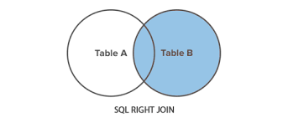
Right Join Fundamentals
Key Points:
Includes all right table rows
Joins left table matching rows
Where no match, left has NULLs
Useful for keeping all secondary records
The right join focuses on including complete right side data, while selectively merging associated left table information. This ensures no missing secondary table records in analysis.

Slide 26
Right Join Fundamentals
Examples Using AdventerWorks2012:
Get all product models with any matching products:
SELECT p.Name, pm.Name AS ModelName
FROM Production.Product p
RIGHT JOIN Production.ProductModel pm
ON p.ProductModelID = pm.ProductModelID;
Get all product inventory snapshots with product info if available:
SELECT p.Name, pi.Shelf, pi.Quantity
FROM Production.Product p
RIGHT JOIN Production.ProductInventory pi
ON p.ProductID = pi.ProductID;

Slide 27
Full Outer Join Fundamentals
FULL OUTER JOIN Complete Data
Matching and Unmatched Rows from Both Tables
Returns all rows from the left and right tables
If no match, columns are NULL for missing side
Very inclusive of all table data
FULL OUTER JOIN Example:
SELECT *
FROM TableA a
FULL JOIN TableB b
ON a.id = b.a_id

Slide 28
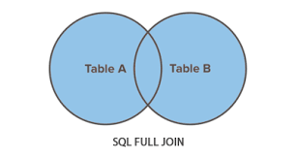
Full Outer Join Fundamentals
Key Points:
Results in full data from both tables
Useful for complete analysis
Locate gaps not found in other joins
Understand all edges of data
The full join provides complete insight into table data by including both matches and non-matches between tables..

Slide 29
Full Outer Join Fundamentals
Examples Using AdventerWorks2012:
Get all products and product models with matches and non-matches:
SELECT p.Name, pm.Name AS ModelName FROM Production.Product p
FULL OUTER JOIN Production.ProductModel pm
ON p.ProductModelID = pm.ProductModelID;
Get inventory snapshots combined with all products, even those lacking snapshots:
SELECT p.Name, pi.Shelf, pi.Quantity
FROM Production.Product p FULL OUTER JOIN Production.ProductInventory pi
ON p.ProductID = pi.ProductID;

Slide 30
Joins Enabled Aggregated Analysis
Blending Joins and Aggregates
Joining with aggregates refers to first joining multiple tables in a SQL query, and then aggregating the resulted joined data using functions like SUM, COUNT, AVG, etc.
For example, you could:
Join a customers table to an orders table to associate each customer with their orders
Then, aggregate the joined data to summarize rather than seeing individual rows
This allows you to analyze both the relationships between tables with the join, along with aggregated summaries in the same query - blending row level and summary data together.

Slide 31
Joins Enabled Aggregated Analysis
Join a customers table to an orders table to associate each customer with their orders
SELECT c.name, o.amount
FROM customers c
JOIN orders o ON c.id = o.customer_id
Then, aggregate the joined data to summarize rather than seeing individual rows
SELECT c.name, SUM(o.amount) total_spent
FROM customers c
JOIN orders o ON c.id = o.customer_id
GROUP BY c.name

Slide 32
Joins Enabled Aggregated Analysis
What Insights to Unlock:
Total order revenue per customer
Average product price per category
Max purchase amount by city
Rank highest grossing product regions
Requirements:
Related tables via foreign/primary keys
Columns to aggregate after joining
Group by columns to slice summaries
Benefits:
Blend granular and aggregate analysis
Expand insights beyond individual tables
Comprehensive data perspective

Slide 33
Joins Enabled Aggregated Analysis
SQL Syntax Pattern
SELECT customers.name, SUM(orders.amount) AS total_purchased
FROM customers
INNER JOIN orders
ON customers.id = orders.customer_id
GROUP BY customers.name
In this case:
We join the customers and orders tables on the customer id
Select the customer name and sum of order amounts
Group the sum of order amounts by customer name
This allows us to get a total purchased amount per customer without needing the HAVING line to filter groups.

Slide 34
Joins Enabled Aggregated Analysis
SQL Syntax Pattern
SELECT customers.name, SUM(orders.amount) AS total_purchased
FROM customers
INNER JOIN orders
ON customers.id = orders.customer_id
GROUP BY customers.name
In this case:
We join the customers and orders tables on the customer id
Select the customer name and sum of order amounts
Group the sum of order amounts by customer name
This allows us to get a total purchased amount per customer without needing the HAVING line to filter groups.

Slide 35
Joins Enabled Aggregated Analysis
Examples Using AdventerWorks2012:
Average reseller sales amount per year:
SELECT YEAR(sh.OrderDate) AS OrderYear, AVG(sd.LineTotal) AS AverageSales
FROM Sales.SalesOrderHeader sh
INNER JOIN Sales.SalesOrderDetail sd
ON sh.SalesOrderID = sd.SalesOrderID
GROUP BY YEAR(sh.OrderDate)

Slide 36
Joins Enabled Aggregated Analysis
Examples Using AdventerWorks2012:
How many times has each product been ordered?:
SELECT p.Name as Product, COUNT(sod.SalesOrderDetailID) AS OrderCount
FROM Production.Product as p
INNER JOIN Sales.SalesOrderDetail AS sod
ON sod.ProductID = p.ProductID
GROUP BY p.Name

Slide 37
Building Queries with Multiple Joins
Multiple joins refers to when you JOIN more than two tables together in a SQL query.
Usually when we think about joins, we picture joining two tables based on some relationship. For example, joining a customers table to an orders table.
However, SQL supports joining any number of tables together in one query by specifying multiple JOIN statements.
For example, we could JOIN:
Customers
Orders
Order_Items
Products
All within the same query to incorporate data from those 4 tables into the result set.

Slide 38
Building Queries with Multiple Joins
SQL queries can contain multiple JOIN clauses
Add joins incrementally to build query complexity
Order of joins impacts intermediate result sets
Optimizing join order is performance tuning
Key Points:
Add joins for additional table relationships
Be thoughtful on join order and impact
Analyze performance of alternative designs
Craft right joins to solve business questions

Slide 39
Building Queries with Multiple Joins
Here is the syntax for using multiple JOIN statements in a SQL query:
SELECT columns
FROM Table1
JOIN Table2
ON Table1.id = Table2.t1_id
JOIN Table3
ON Table2.id = Table3.t2_id
JOIN Table4
ON Table3.id = Table4.t3_id
WHERE conditions
ORDER BY columns
LIMIT number

Slide 40
Building Queries with Multiple Joins
In this syntax:
There are multiple JOIN clauses to join Table1, Table2, Table3 and Table4
Each JOIN has its own ON clause to define the relationship between the tables
Can include WHERE, ORDER BY, LIMIT etc around the joins
Some key points:
JOIN order goes from initial table progressively
Each JOIN references the tables joined up to that point via aliases
Can chain many JOINs to connect extensive relationships
We just keep incrementally adding JOIN clauses to relate additional tables to the query.

Slide 41
Building Queries with Multiple Joins
Examples Using AdventerWorks2012:
Joining Products, Categories, Subcategories:
SELECT p.Name, c.Name AS Category, sc.Name AS Subcategory
FROM Production.Product AS p
INNER JOIN Production.ProductSubcategory AS sc
ON p.ProductSubcategoryID = sc.ProductSubcategoryID
INNER JOIN Production.ProductCategory AS c
ON sc.ProductCategoryID = c.ProductCategoryID;

Slide 42
Building Queries with Multiple Joins
Examples Using AdventerWorks2012:
Joining Person, Employee, and Email tables:
SELECT p.Name, c.Name AS Category, sc.Name AS Subcategory
FROM Production.Product AS p
INNER JOIN Production.ProductSubcategory AS sc
ON p.ProductSubcategoryID = sc.ProductSubcategoryID
INNER JOIN Production.ProductCategory AS c
ON sc.ProductCategoryID = c.ProductCategoryID;

Slide 43
Joining a Table to Itself
A self join allows you to match a row in a table to other rows in the same table.
It lets you connect data back to itself instead of joining to a different table.
For example, imagine you have an employees table listing all employees at a company. That table has columns like:
Id - A unique number for each employee
Name
ManagerId - The Id number of the person's manager
You could use a self join to match employees to their manager by comparing the Id and ManagerId columns.

Slide 44
Joining a Table to Itself
Common Self Join Scenarios
Modeling Hierarchies & Graphs:
Employees to Managers
Categories to Parent Categories
Folder Structures
Bill of Materials Assemblies
Network / Tree Structures
Summary:
Self joins are ideal for querying data with logical hierarchies, structures, and relationships within the same table.

Slide 45
Joining a Table to Itself
Basic Syntax:
SELECT t1.col1, t2.col2
FROM table t1
JOIN table t2
ON t1.key = t2.ref_key
Key Points:
Alias the table each time
Resolve ambiguous columns
Compare alias versions

Slide 46
Joining a Table to Itself
Examples Using AdventerWorks2012:
Product Inventories to Preceding:
SELECT pi1.Shelf, pi2.Shelf AS PrevShelf
FROM Production.ProductInventory pi1
JOIN Production.ProductInventory pi2
ON pi1.ProductID = pi2.ProductID

Slide 47
Joining a Table to Itself
Examples Using AdventerWorks2012:
Pairs of people from that Person table with the same last name
SELECT p1.FirstName, p1.LastName,
p2.FirstName AS RelativeFirstName, p2.LastName AS RelativeLastName
FROM Person.Person p1
JOIN Person.Person p2
ON p1.BusinessEntityID <> p2.BusinessEntityID
AND p1.LastName = p2.LastName

Slide 48
Summary
Best Practices:
Use aliases for easier coding
Multiple joins to connect more tables
Aggregate and filter joined data
Optimize join order and performance
Visualize expected output for validation
Purpose:
Joins deliver a foundation for many analytical tasks by interrelating data distributed across tables. Careful construction and validation enables deriving maximum value.

Slide 49
Exercise
Introduction: AdventureWorks Sample Database
Includes data for fictitious bike manufacturer
Widely used to demonstrate SQL Server examples
We will query and analyze data Using the Production.Product table
Instructions: Follow the steps outlined in each section.

Slide 50
Exercise 1 - Question
Inner joins
What are the standard costs for ‘Road-150 Red, 62’ bike model?
The Product table lists individual products
It links to ProductCostHistory which tracks costs over time
We can join the tables to match rows

Slide 51
Exercise 1 - Answer
What are the standard costs for the ‘Road-150 Red, 62’ bike model?
SELECT p.Name, pch.StandardCost
FROM Production.Product AS p
JOIN Production.ProductCostHistory AS pch
ON p.ProductID = pch.ProductID
WHERE p.Name = 'Road-150 Red, 62’;
Explanation:
Get 'Road-150 Red, 62’ products
Join to related cost history
Match rows where ProductID lines up

Slide 52
Exercise 2 - Question
LEFT JOIN
Which products don't have a product model assigned?
The Product table contains all products
Some products are associated with models ID’s the ProductionModel table
We can use a left join to see what products lack a model

Slide 53
Exercise 2 - Answer
Which products don't have a product model assigned?
SELECT p.Name
FROM Production.Product AS p
LEFT JOIN Production.ProductModel AS pm
ON p.ProductModelID = pm.ProductModelID
WHERE pm.ProductModelID IS NULL;
Explanation:
Shows products missing related model
Matches all products to models if available
NULL model means no match

Slide 54
Exercise 3 - Question
RIGHT JOIN
How many product model illustrations don't have an actual product model assigned?
Product Models are in Production.ProductModel
Illustrations in ProductionModel.Illustration
Right join checks illustrations lacking photos

Slide 55
Exercise 2 – Question - Answer
How many product model illustrations don't have an actual product model assigned?
SELECT COUNT(*) Missing_Product_Models
FROM Production.ProductModelIllustration AS pmi
RIGHT JOIN Production.ProductModel AS pm
ON pmi.ProductModelID = pm.ProductModelID
WHERE pmi.ProductModelID IS NULL;
Explanation:
Illustrations may be missing ProductModels
Matches all ProductModels rows
Counts NULL model links as missing
Useful for finding gaps vs doing left join

Slide 56
Exercise 4 - Question
OUTER JOIN
How many product models are missing product model illustrations?
Product Models are in Production.ProductModel
Illustrations in ProductionModel.Illustration
Any NULL illustration values would signify missing assets for that model.

Slide 57
Exercise 4 - Answer
How many product models are missing product model illustrations?
SELECT COUNT(*) AS MissingIllustrations
FROM Production.ProductModel pm
FULL OUTER JOIN Production.ProductModelIllustration pmi
ON pm.ProductModelID = pmi.ProductModelID
WHERE pmi.ProductModelID IS NULL;
Explanation:
Do full join between models and illustrations
If no matching illustration, counted
Shows gaps where models lack illustration
Useful for finding missing entity connections

Slide 58
Exercise 5 - Question
JOIN with Aggregates
What are the total inventory quantities for each product?
Production Products are in Production.Product Table
Product Inventory is in the Production.ProductInventory Table

Slide 59
Exercise 5 - Answer
What are the total inventory quantities for each product?
SELECT p.Name AS Product,
SUM(inv.Quantity) AS TotalQuantitySnapshots
FROM Production.Product p
JOIN Production.ProductInventory inv
ON p.ProductID = inv.ProductID
GROUP BY p.Name
ORDER BY TotalQuantitySnapshots DESC;
Explanation:
Join Product to ProductInventory snapshots
Aggregate historical quantities for each product

